Slide 1
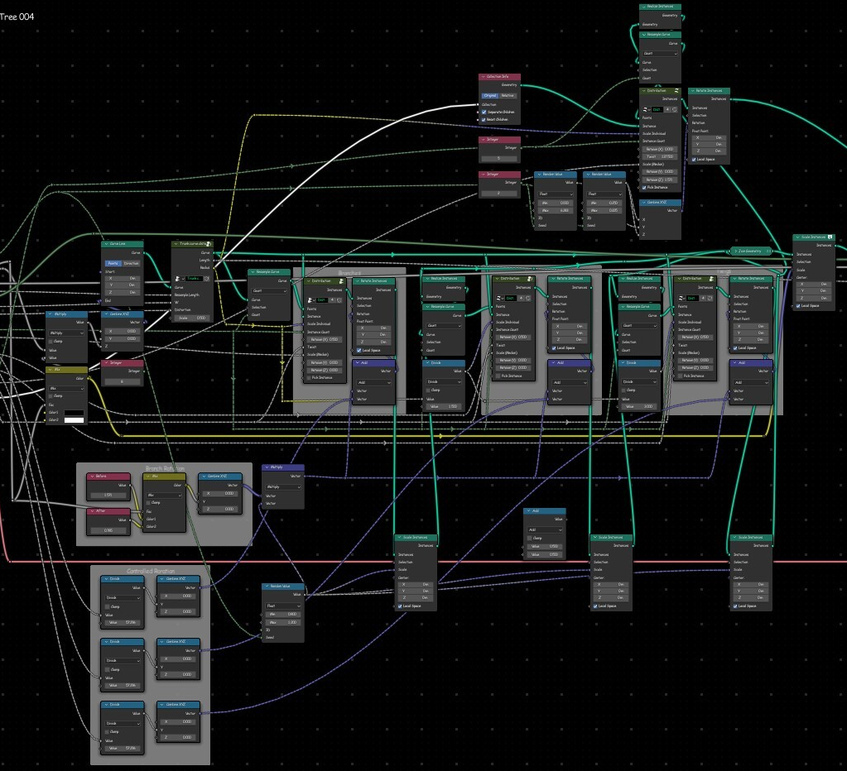
Abhay’s Tool-Kit
Guide

Slide 2
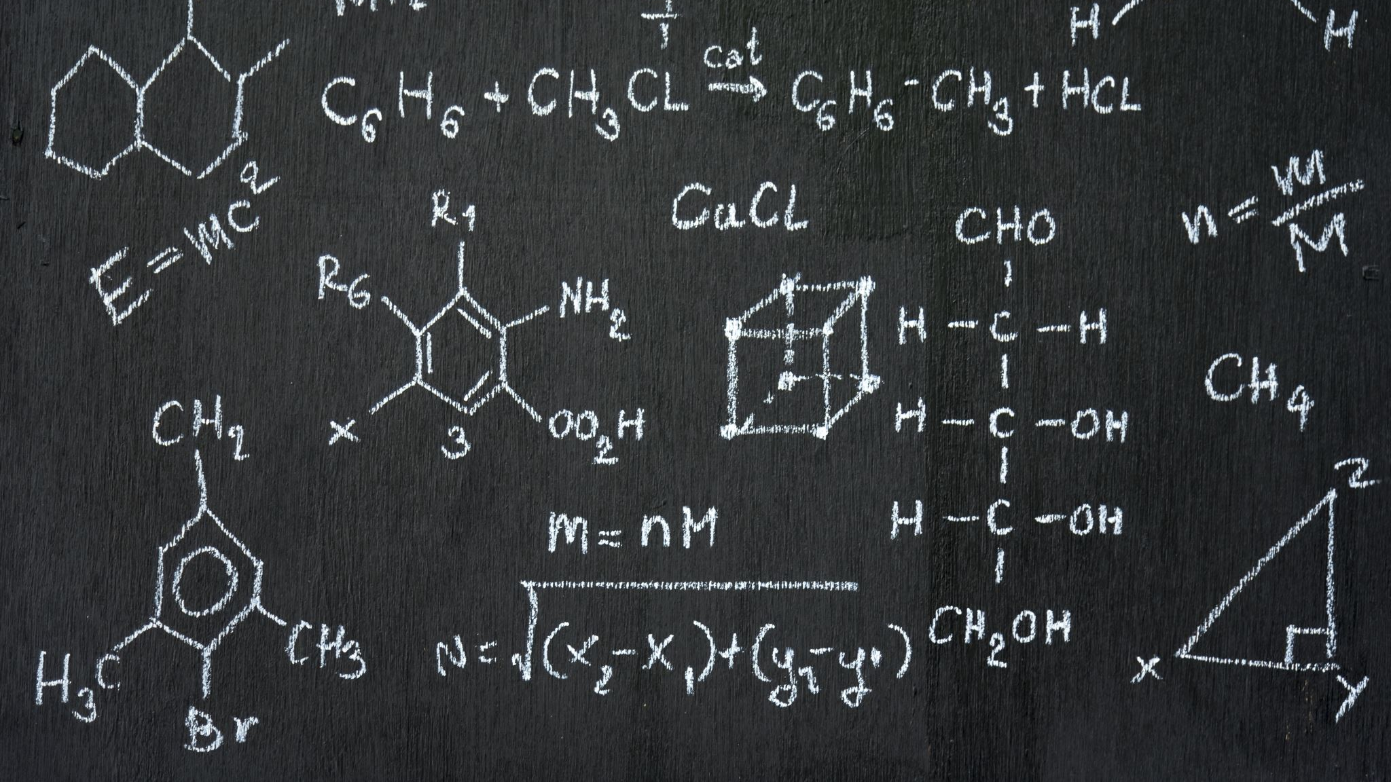
Contents
Introduction
Curves
Curves Primitives
Examples
Generators
Geometry
Instances
Mesh Primitives
Points
Selection
Utilities
Vector

Slide 3

Introduction
Blender's Geometry Nodes system is a powerful tool for procedural modelling and animation. However, users often face challenges in reusing and managing complex node setups across projects. This Tool-Kit aims to simplify and enhance the workflow for Blender users by creating a Collection of reusable Geometry Node groups and an intuitive addon for seamless integration into Blender's interface. And,
This is the Guide to the Nodes groups in the Tool-Kit. Here I will be explaining what these nodes groups do, how to use them, and there use case.

Slide 4

Curves
List of Node Groups
Rebuild Curve (Spline Index Remapper)
Change Spline Type
Curve Deform
Curve Optimize (for edge path to curves)
Curve Optimization Iteration
Loft Curves
Loop Curve
Curve Rebuilder (Curve Island Index)
Skin Curve
Spline Factor
Curves Splitter

Slide 5
Rebuild Curves (Spline Index Remapper)
Description: This node group is specially designed for reindexing and re organising spline topology. It rebuilds curve topology by destroying original spline organising and reassigning points to new splines based on Group ID attribute, Outputs reindexed curves with uniform cyclic state control.
Use cases:
Spline consolidation: Merging multiple splines into single spline(assign same Group ID to all points).
Spline fragmentation: Split single spline into multiple segments based on Group ID.
Topology reordering: Change spline rendering order.
Change Spline Type
Description: Dynamically converts curve spline type between poly, Bezier, catmull rom and NURBs with selection based control - enables smoothing of sharp corners, mathematical curve refinement and automatic handle manipulation through a unified interface.
Curve Select Index driven switch (0 = poly, 1 = Bezier, 2 = catmull rom and 3 = NURBs)
Use case: converts jagged poly curves into smooth curve for organic shapes.

Slide 6
Curve Deform
Description: Deform input geometry along a target curve. It aligns geometry to the curve’s tangent while preserving local shapes with axis selection determining direction. Ideal for creating roads, pipes, vines or any geometry that needs to follow a curved path.
You can reference curve object from the scene or process curves directly from geometry nodes.
The ‘Curve Index’ input handles objects with multiple splines deform difference meshed to different splines in the same object.
It preserves original mesh topology.
You can adjust curve path after the deformation.
[Credit: Implementation approach based on Erindale’s Curve deformation tutorial(YouTube).]
Curve optimize (for edge path to curve)
Description: Optimize the output curves from ‘edge path to curves’. Fixing high density of curves due to overlapping.
Curve Optimization Iteration
Description: Optimize overlapping Curves (singular iteration, you’ll have to use multiple until you get the desired result). An alternate to the “AST_Curve_Optimize (edge path to curves)” captured length input takes the spline length from a capture attribute node and pass it to the next iteration or you can use a repeat zone as well.

Slide 7
Loft Curves
Description: Generates seamless tubular surface between input profile curves. Made this from Erindale’s tutorial but mine is little different. It connects curve profiles with adaptive geometry creating organic shapes like pipes, tentacles, sculpted surfaces or parametric designs. It offers precise control over mesh density and interpolation for both longitudinal and cross-section direction.
Converts curves into continuous surfaces. [Credit: Core algorithm based on Erindale’s Curve lofting tutorial(YouTube).]
Loop Curve
Description: Created this because I forgot there’s a ‘set spline cyclic’ node. I kept this as a reminder of my stupidity (!_!). Still useful for learning purpose.
Curve Rebuilder (Curve Island Index)
Description: Branching curves are actually more than one curve. It convert input curves into mesh and extract the island index. Then convert back to curves with same number of points. Allowing you to have a index for curve islands. Even though those curve islands are actually more than one curve with overlapping endpoints. Automatically reversing spline direction when needed to match original curve direction.

Slide 8
Skin Curve
Description: Converts input curves into tubular meshes by extruding a circular profile along the spline with precise control over radius, resolution and UV mapping. Generates parametric pipes, cables or organic forms, while maintaining clean topology and customisable UV mapping.
Spline Factor
Description: Generates a factor attribute along al the input curves. Also outputs normal individual factor from spline parameter as well.
Curve Splitter
Description: Splits the desired endpoint of all the input splines into 2,3 or random branching. Very useful in creating foliage and trees has all the necessary controls for large branches into multiple small branches with randomization, split point control, opening of branches as well as direction and rotation of split.

Slide 9

Curve primitives
List of Node Groups
Bezier
Curve Arch
Half Star
Mirrored Bezier
Natural Spiral
Nuclear Curve

Slide 10
Bezier
Description: It is a basic Quadratic Bezier but, with reorganised parameters. New parameters are simplifies to expose to the modifiers panel after you done building your project with it. Spline factor and spline length is also directly exposed from it for the ease of convince.
Its main focus is foliage creation. Things you create with it are easy to modify or are simple to use by others.
Curve Arch
Description. It’s a arch shaped curve useful in creating arch ways and windows. All the parameters are self explanatory.
Half Star
Description: A curve in the shape of a star that is sliced from the middle. Smooth it with a ‘change spline type’ node to create some organic shapes useful in making certain types of leaves.
Mirrored Bezier
Description: Same as ‘AST_Bezier’, its just a quadratic Bezier with reorganized controls and simplified parameters. But its mirrored. Making it useful in profiling other curves. Play with its parameters once you done making your model and see the usefulness.

Slide 11
Natural Spiral Description: It is a curve that mimics the way branches, stems, and plants curls up in the nature. Making it ideal for foliage creation, specially useful in making in ferns, branches and leaves. Nuclear Curve Description: A curve in the shape of nuclear hazard sign. Move its center to create leaves like Livistona plant or combine it with a “AST_Change Spline Type” to create instructing patterns and mandolas.

Slide 12

Examples
List of Node Groups
Cotton Gula
Curvy Branch
Infinity
Leaf-simple
Ligulate-Petal
Lofting with profiles
Palm Lanceolate
Petal 2
Shortest edge path optimize

Slide 13
Cotton Square Description: A bloom-able cotton square without cotton that I created using nodes groups from my toolkit. It showcase the techniques that I use for creating organic shapes. Curvy Branch Description: It is a singular branch/twig generator that doesn’t have child branches. Showcasing the use-case of “AST_Natural Spiral ”. Infinity Description: A curve in the shape of infinity useful for animating something that requires to move in the infinity shape or for creating parametric designs. Leaf Simple Description: A simple leaf generator made using the nodes “AST_Bezier” and “AST_Mirrored Bezier” from this toolkit. With so much control over shape and useful parameters. Ligulate-Petal Description: A ligulate petal generator made using nodes from this toolkit. Very useful or creating flowers with ligulate petals like ‘Daisy’.

Slide 14
Lofting with profiles Description: A example “AST_Loft Curve” with preloaded profiles. Just give it a Bezier Curve and it will show you a smart technique of lofting curves with auto curve sorting. By attaching the profiles to the input Bezier. You can edit the Bezier afterwards. Palm Lanceolate Description: Individual segment of the palm leaves made with “AST_Bezier” and “AST_Mirrired Bezier”. Modify the parameters a little and it will go for a variety of trees with similar leaves. Petal 2 Description: A simple petal generator. Type that usually found in vie leaves flowers or in wild. Made using “AST_Natural Spiral”. Shortest edge path optimize Description: An example of how to optimize the geometry made using shortest edge path technique.

Slide 15

Generators
List of Node Groups
Di-Circle Pattern
Gothic Table Generator
Pattern {2}
Pottery
Rock Generator
Tree – 50+
Notes:
r

Slide 16
Di-Circle Pattern Description: A Circular Mandola/pattern Generator, Changing each parameter randomize the mandola. It adds two Vector circles to create these patterns. Gothic Table Generator Description: A round table generator in gothic style. Fully customizable with 18 parameters. Pattern {2} Description: A round pattern generator useful for making parametric designs. This pattern generator provides more controls over the pattern you generate. Pottery Description: It is a pot Generator with Bezier input. Just give it a Bezier in the shape of Desired pot profile(only one side) and it will generate the pot from that profile. Rock Generator Description: A procedural Rock/Boulder Generator. You can even generate rocks in custom shapes by giving it a rough shaped geometry of the rock. By turning off the ICO option. Otherwise it will generate without input geometry. You can also Ramesh the rock within the node. Try all the parameters for better understanding of their use.

Slide 17
Tree – 50+ Description: A tree generator with more than 50 parameters to customize it. Useful for instantly creating trees for your scenes. It can be used for creating a variety of trees like fantasy, artistic, spooky, wild trees etc.

Slide 18

Geometry
List of Node Groups
Align to Grid Plane
Bounding Box +
Bounding Box Group Index
Bounding Grid
Bounding Lattice
Rotate Geometry
Self Iteration (Caution)
Selective Join Geometry
Simplify for Viewport
Transform Geometry +

Slide 19
Align to Grid Plane Description: Moves the input geometry so that its lowest point sits on the viewport grid plane. Very handy node while instancing things or sampling objects from viewport. Bounding Box + Description: A bounding box node with pre-organized outputs for faster workflow. Consider the bottom plane of the bounding box of your geometry as A,B,C and D. and top plane as A’, B’, C’ and D’. It output all the corner position of the bounding box along with its center, center of bottom plane(base), scale and bounding surface area. Where A is the “MIN” point and C’ is the “MAX” point. Just hide the unnecessary outputs with ‘ctrl+h’ after plugging the needed outputs. Bound Box Group Index Description: Grouped Bounding Boxes. “Creates bounding boxes for each loose or group indexed geometry”. Or geometry with multiple meshes. Input the mesh island’s island index in the group index. Output vectors are field output accordingly. Learned this node from Erindale’s Tutorial on bounding boxes. Bounding Grid Description: Create a grid on the lowest point of the input geometry. Scales to the X and Y size of the input geometry. Bounding Lattice Description: Creates a Lattice around the input geometry matching the bounding box.

Slide 20
Rotate Geometry Description: Rotate geometry with field inputs, unlike transform geometry where you can only rotate whole geometry. With this node you can rotate the selected part of your geometry with smooth falloff. You can choose Axis, center of rotation and angle. Factor input is where you put the mask of selected geometry. Self Iterate Geometry Description: Distribute itself of its own points with each iteration Caution: only use simple geometry with lesser vertex count. Using high density mesh or geometry will cause your pc to freeze of crash. Useful in creating abstract art. Selective Join Geometry Description: it lets you join 5 geometries on the base geometry with an index switch. Each iteration of the index switch adds up the next input geometry to the base geometry. Use case: Imagine you made a tree. Now, you want to control the visibility of each part o your tree(e.g., base branches, secondary branches, roots, twigs, leaves etc). You can just plug in the different parts of your tree in the geo inputs on this node. And connect the index switch to the group input. Simplify for Viewport Description: Lets you convex Hull the heavy geometry but automatically switch to original geometry when you render. Very useful when dealing with Heavy instances. Just plug it in between you geometry that you want to instance and Instance on Points node.

Slide 21
Transform Geometry + Description: Basic Transform Geometry node but with field inputs, meaning you can transform geometry selectively or input field values. Also have a center input which change the center of transformation. Default is 0,0,0.

Slide 22

Instances
List of Node Groups
Align Instance to Topology
Alternate Distribution
Bounding Box Instances
Circular Distribution
Collection Info +
Collection Info Custom Index
Instance Packer
Instance on Edges

Slide 23
Align Instances to Topology Description: Instance on input geometry with perfect alignment to face normal and center of the input geometry. Alternative Distribution Description: Distribute instances on a curve in alternate direction or in opposite direction like leaves on twigs of some plants, useful for creating foliage and plants. Bounding Box Instances Description: Creates bounding boxes for instances. Learned in from Erindales’s tutorial on Bounding Boxes. Circular Distribution Description: Distribute instances in a circular manner with tilt, twist and rotation control. Collection Info + Description: Collection Indo with collection bounding boxes and MIN and MAX vectors. Useful for Instance Packing. Learned it from Erindale’s tutorial on Instance packing.

Slide 24
Collection Info Custom Index Description: Collection info with index based on position on chosen axis or circular index. You can reverse the index afterwards. You can also move around the items in your collection in viewport and it will automatically update index in geometry nodes. Very useful node in making interactable models. Instance Packer Description: For packing objects that are not same size perfectly spaced. According to their size. Need collection info + to pair with it. Instance on Edges Description: Distribute instances on edges. Surface normal input aligns the rotation of instances to the input geometry.

Slide 25
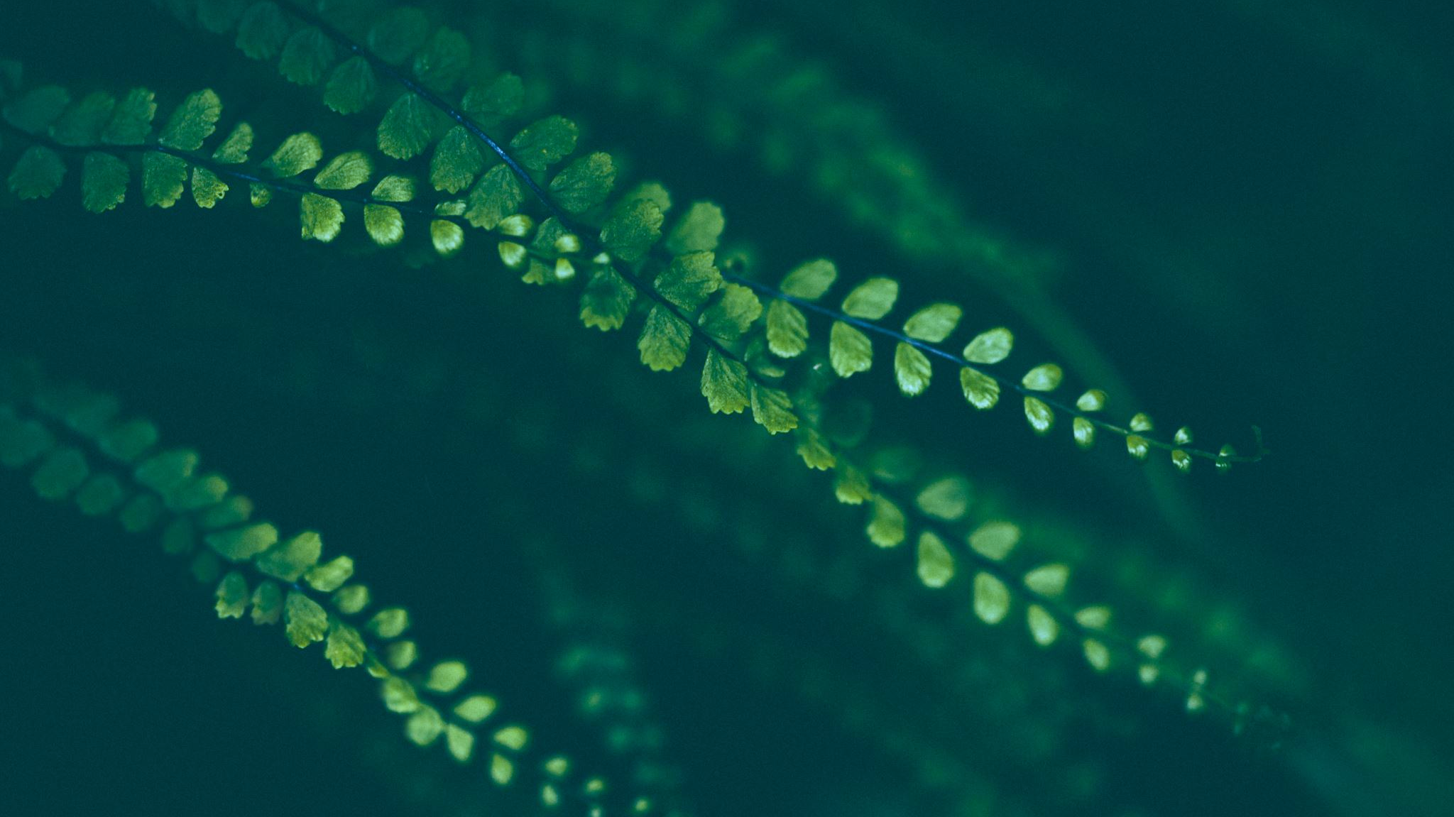
Mesh Primitives
List of Node Groups
Aloe vera leaf
Balloon
Icosahedron
Julia Fractal
Lattice
Prism
Pyramid
Slicing Circle
Tetrahedron

Slide 26
Aloe vera leaf Description: An Aloe Vera leaf generator. Can be modified to make similar plants too, e.g. cacti. Balloon Description: a balloon generator useful as a place holder for instancing something. Icosahedron Description: AN icosahedron generator, useful as placeholder for instancing something. Julia Fractal Description: A 4D fractal called Julia. Lattice Description: A lattice generator, useful for making buildings, houses etc Prism Description: A prism generator, useful as placeholder for instancing something. Pyramid Description: A pyramid generator, useful as placeholder for instancing something. Slicing Circle Description: A circle that can be bisected at any point. Useful as placeholder for leaves in foliage creation. Tetrahedron Description: A tetrahedron generator, useful as placeholder for instancing something.

Slide 27
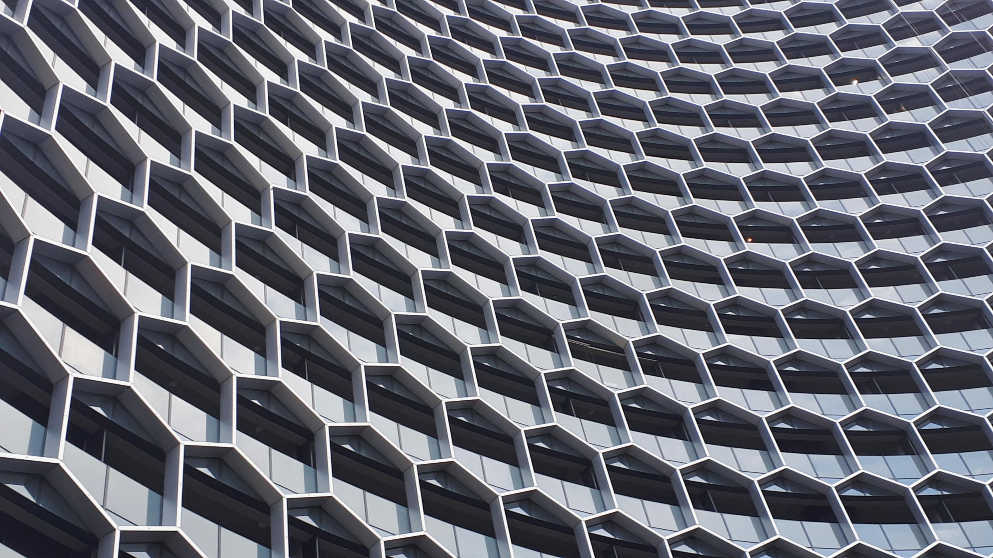
Modifiers
List of Node Groups
Add Scales
Damage Geometry
Fractal Shaper
Mirror geometry
Points to Lattice
Surface Cobble
Terrain Displacement
Trim Geometry

Slide 28
Add Scales Description: Add scales on the surface of the input geometry. Damage Geometry Description: Damage/Break-ups the input geometry to a old withered look. Fractal Shaper Description: Modulates the input geometry to a stepped look. Useful in landscape creation for creating the different layers of the terrain. Mirror geometry Description: Quickly mirror the input geometry on X or Y axis. Points to Lattice Description: Input a bunch of points and create a kind of lattice out of them. It has very specific use-case like abstract art or creating a plant in certain shape. Surface Cobble Description: Turn the surface of the input geometry into cobblestone. Great for creating cobble stone walls, paths and other rocky assets.

Slide 29
Terrain Displacement Description: Displace a height map into a terrain with precise control and subdivisions setup. Very useful node. I use this all the time for all of my Terrains. Trim Geometry Description: Trim the input geometry on X, Y or Z axis. From both a sides just like a trim curve node. It uses a Boolean node, so its not super fast on heavy meshes.

Slide 30

Points
List of Node Groups
Distribute Points in Curve
Phyllotaxis
Points to spline

Slide 31
Distribute Points in Curve Description: Distribute points in the area that input Curve covers, Weather it is cyclic or not. Non-cyclic curve will have points distributed in the concave area/section. You can control the density of points, randomize them and control probability to spawn. Phyllotaxis Description: Points distributed in Phyllotaxis pattern. Useful for creating organic projects like plants and trees specially flowers. Points to spline Description: Creates a spline from the input points. Little different from the base node. You can choose spline type and have option for inbuild circular weight (Basically it creates a radial gradient from the world center and use it as weight). You can input a position to overwrite the world position for the circular weight.

Slide 32
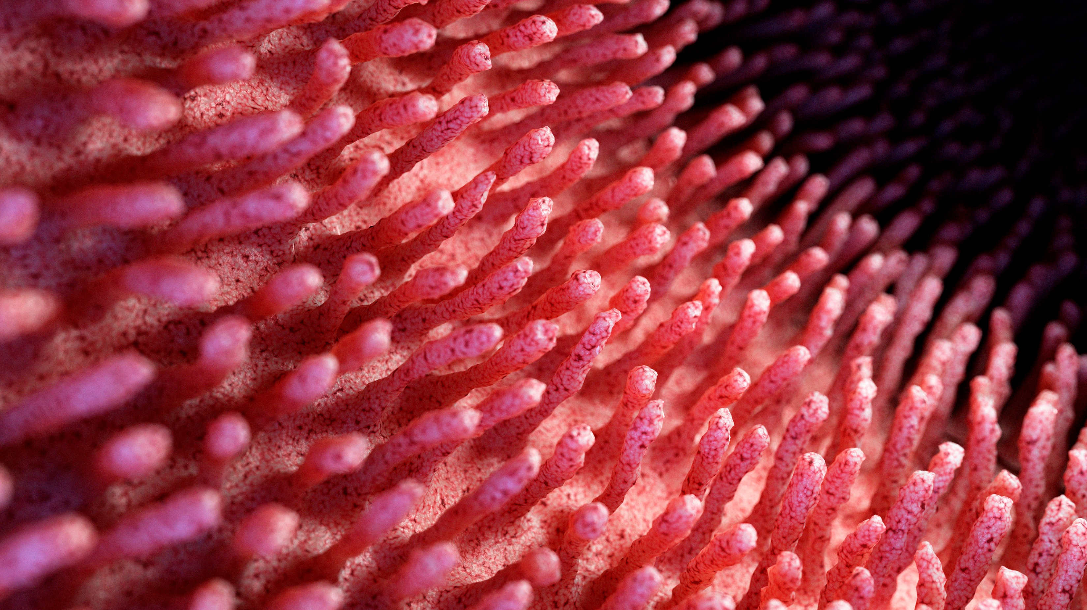
Selection
List of Node Groups
Expand Selection
Mesh Proximity
Minimum Distance
Nearest Point Selection
Select by Direction
Select by Normal
Select by Position
Select by Index

Slide 33
Expand Selection Description: Expand you Boolean selection by one vertex in all directions. Learned it from Erindale’s Tutorial on geometry selection. Mesh Proximity Description: Creates mask and falloff based on the distance and clipping between target and reference geometry. Input takes the geometry from which you want to create the mask. Minimum Distance Description: Output the distance between the input geometry and the location input or the object input. And outputs a selection based on the epsilon. Nearest Point Selection Description: Select the nearest point from the input object (or empty object). Useful in selecting specific points in the input geometry. Select by Direction Description: Select based on a certain angle (facing a certain angle).

Slide 34
Select by Normal Description: Select based on X,Y and Z Direction of the Normals of the geometry. Select by Position Description: Select based on weather the position of input geometry is greater or lesser than the input value on X,Y or Z Axis. Select by Index Description: Select based on the Index occurrence. For e.g. select every 2nd vertex (even). Selection can be inverted by changing the “Equals to” input value. Also allows custom index.

Slide 35
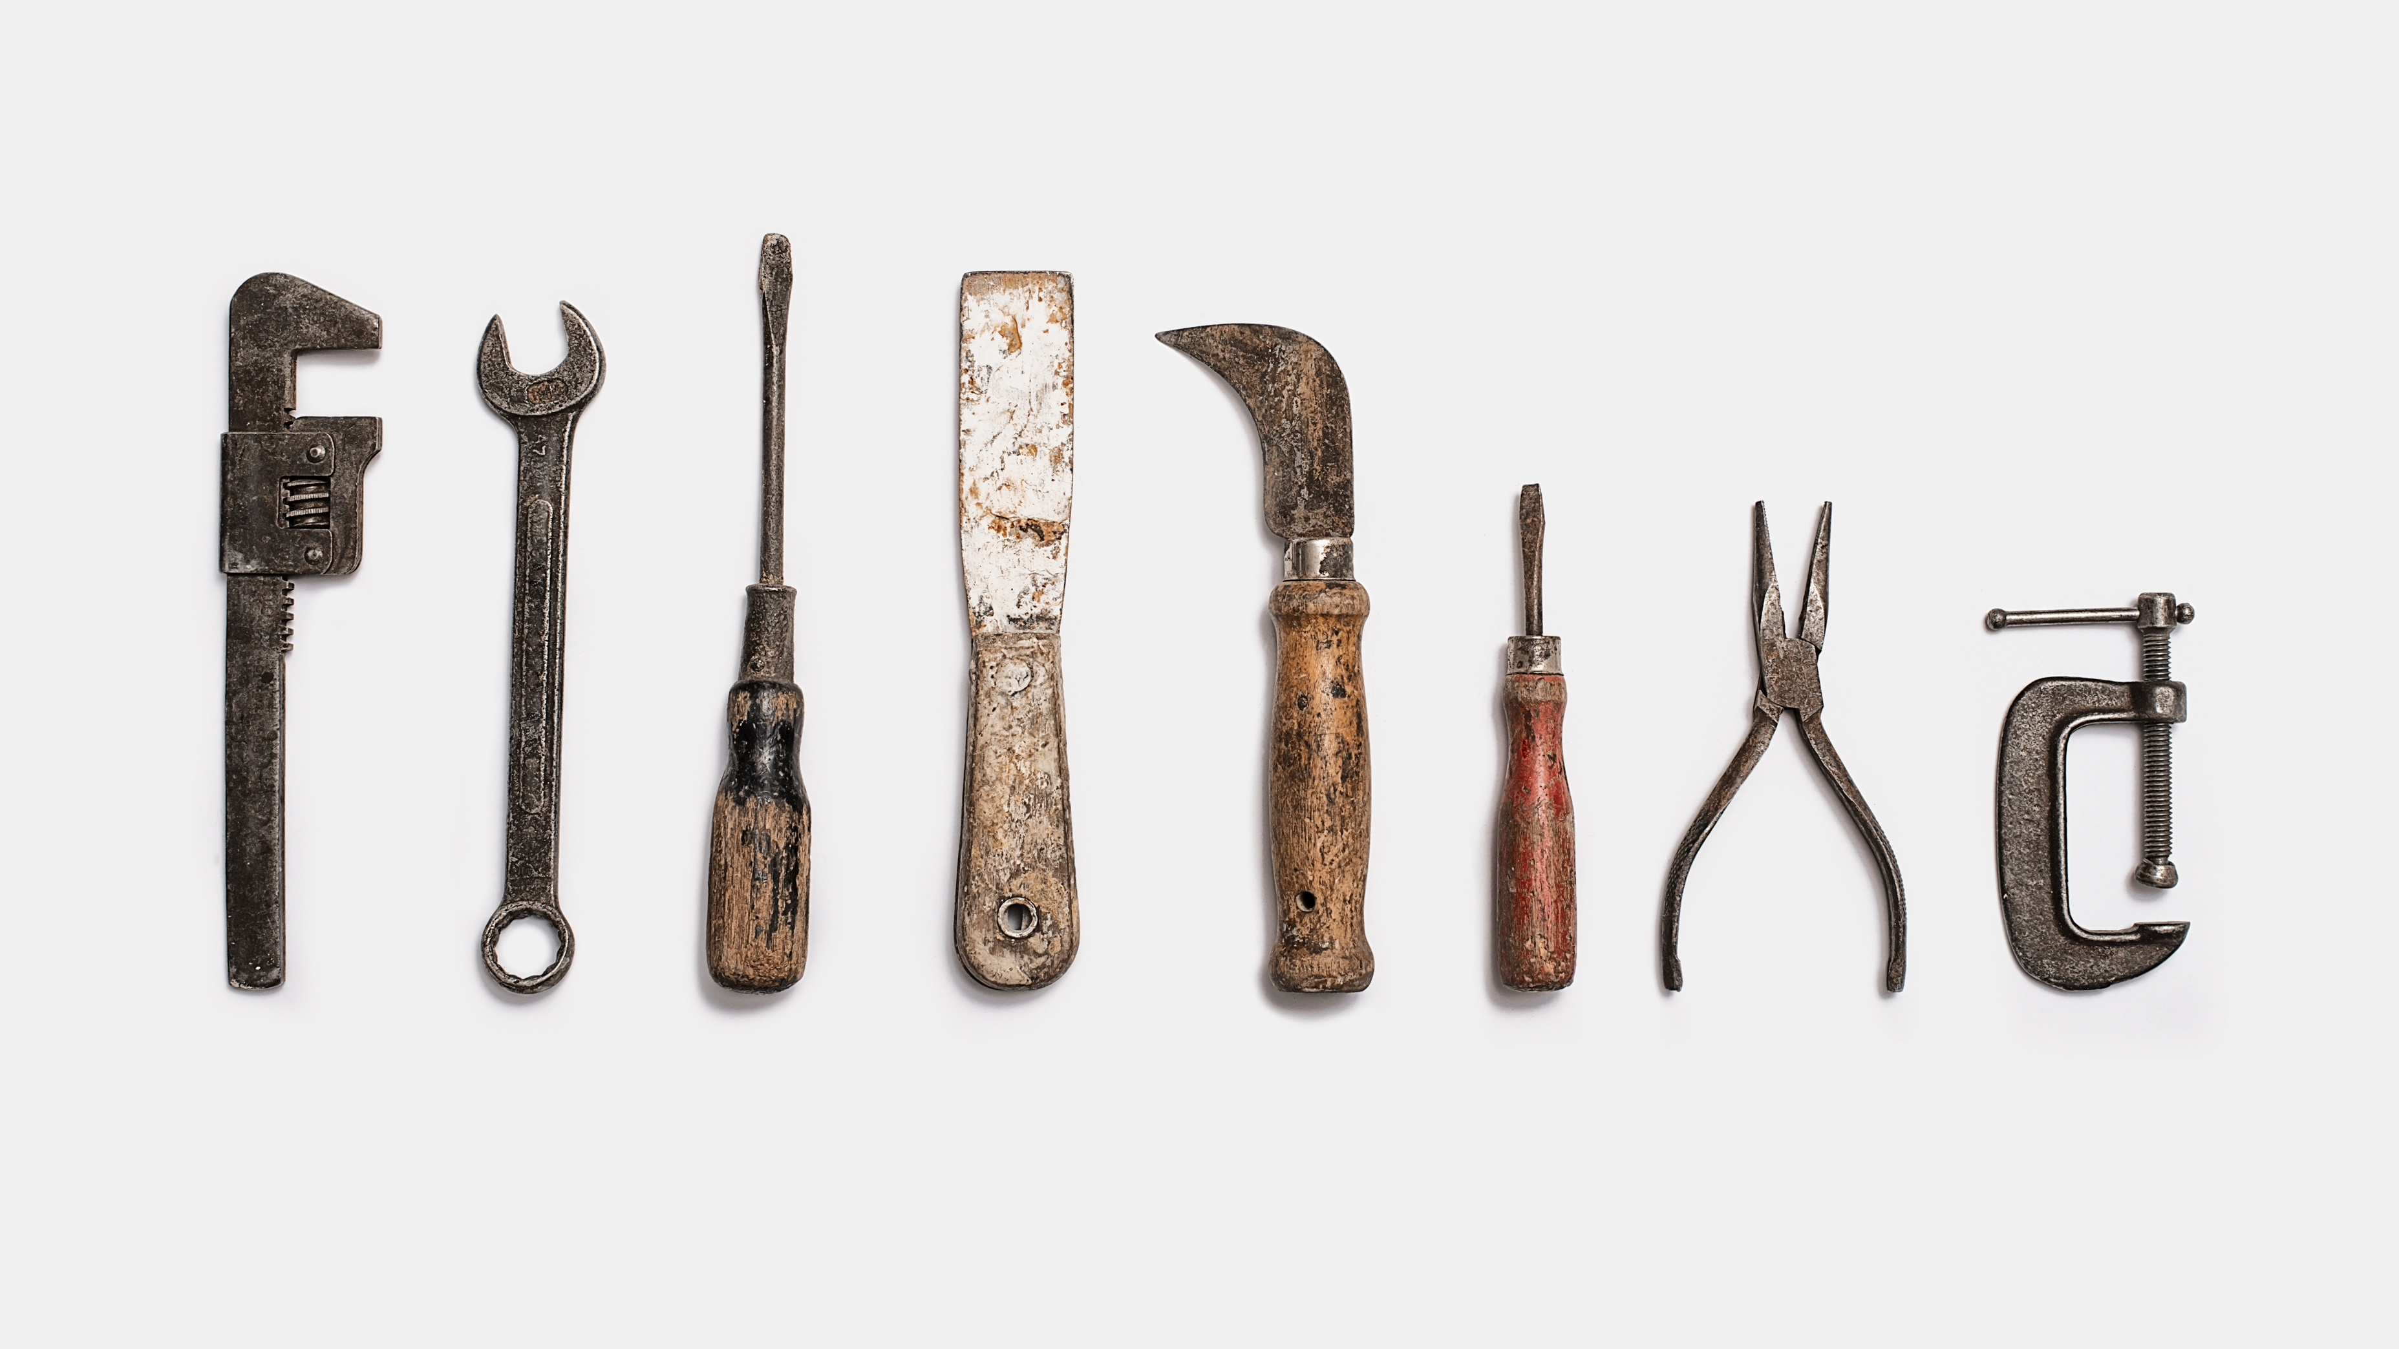
Utilities
List of Node Groups
Accumulate Curve
Degree
Flip Indices
Fold Attribute
Grid Index
Map Attribute
Store Edge Angle
Value++
View Instance Attribute

Slide 36
Accumulate Curve Description: Accumulate the position, tangent and normal of input curve on any position/point on input curve. Control that point using length input. Degree Description: A value node of degree input instead of typical radiant value. Flip Indices Description: Flip the Grid(2D) Indes. For e.g. if your geometry has two indices going on different axis. You can switch them using this node. Learned it from Erindale’s tutorial on Index. Fold Attribute Description: Fold the input attribute at the input value. For e.g. if input attribute ranges from 0 to 1. an the value input set to 1. it will turn the range from “0 to 1” to “0 to 1 to 0”. If value input set to .5 then “0 to 1 to 0 to 1 to 0”. Grid Index Description: Project a grid of index on X and Y coordinates. This custom index can be used to sampling. Use-case joining two ends of two pipes/cylinder with different index. Joining them with their index will create a messy geometry because of the misalignment of their indices. Assign this custom index to both the end loops/circles then join them to create seamless joints.

Slide 37
Map Attribute. Description: Re-range the input attribute. Automatically clamps the minimum value to 0 and maximum value to 1. Store Edge angle Description: Store the edge angle Signed and Unsigned to the geometry for texturing purpose. You can use the stored data in shader nodes using an attribute node with input attribute name set to Signed or Unsigned. Value ++ Description: Value node with some extra options. The positive and negative outputs are positive and negative integer of the base input value. Random in Range{+ -} will give a Random value in between positive and negative integer of the base value. %% input is multiplier to the base value and value to %% will give random value between base value and multiplied result. View Instance Attribute Description: Visualize a float attribute of ‘Instances’ with points through weight output. Radius controls the point radius. Only for viewing the attribute to verify or check it.

Slide 38
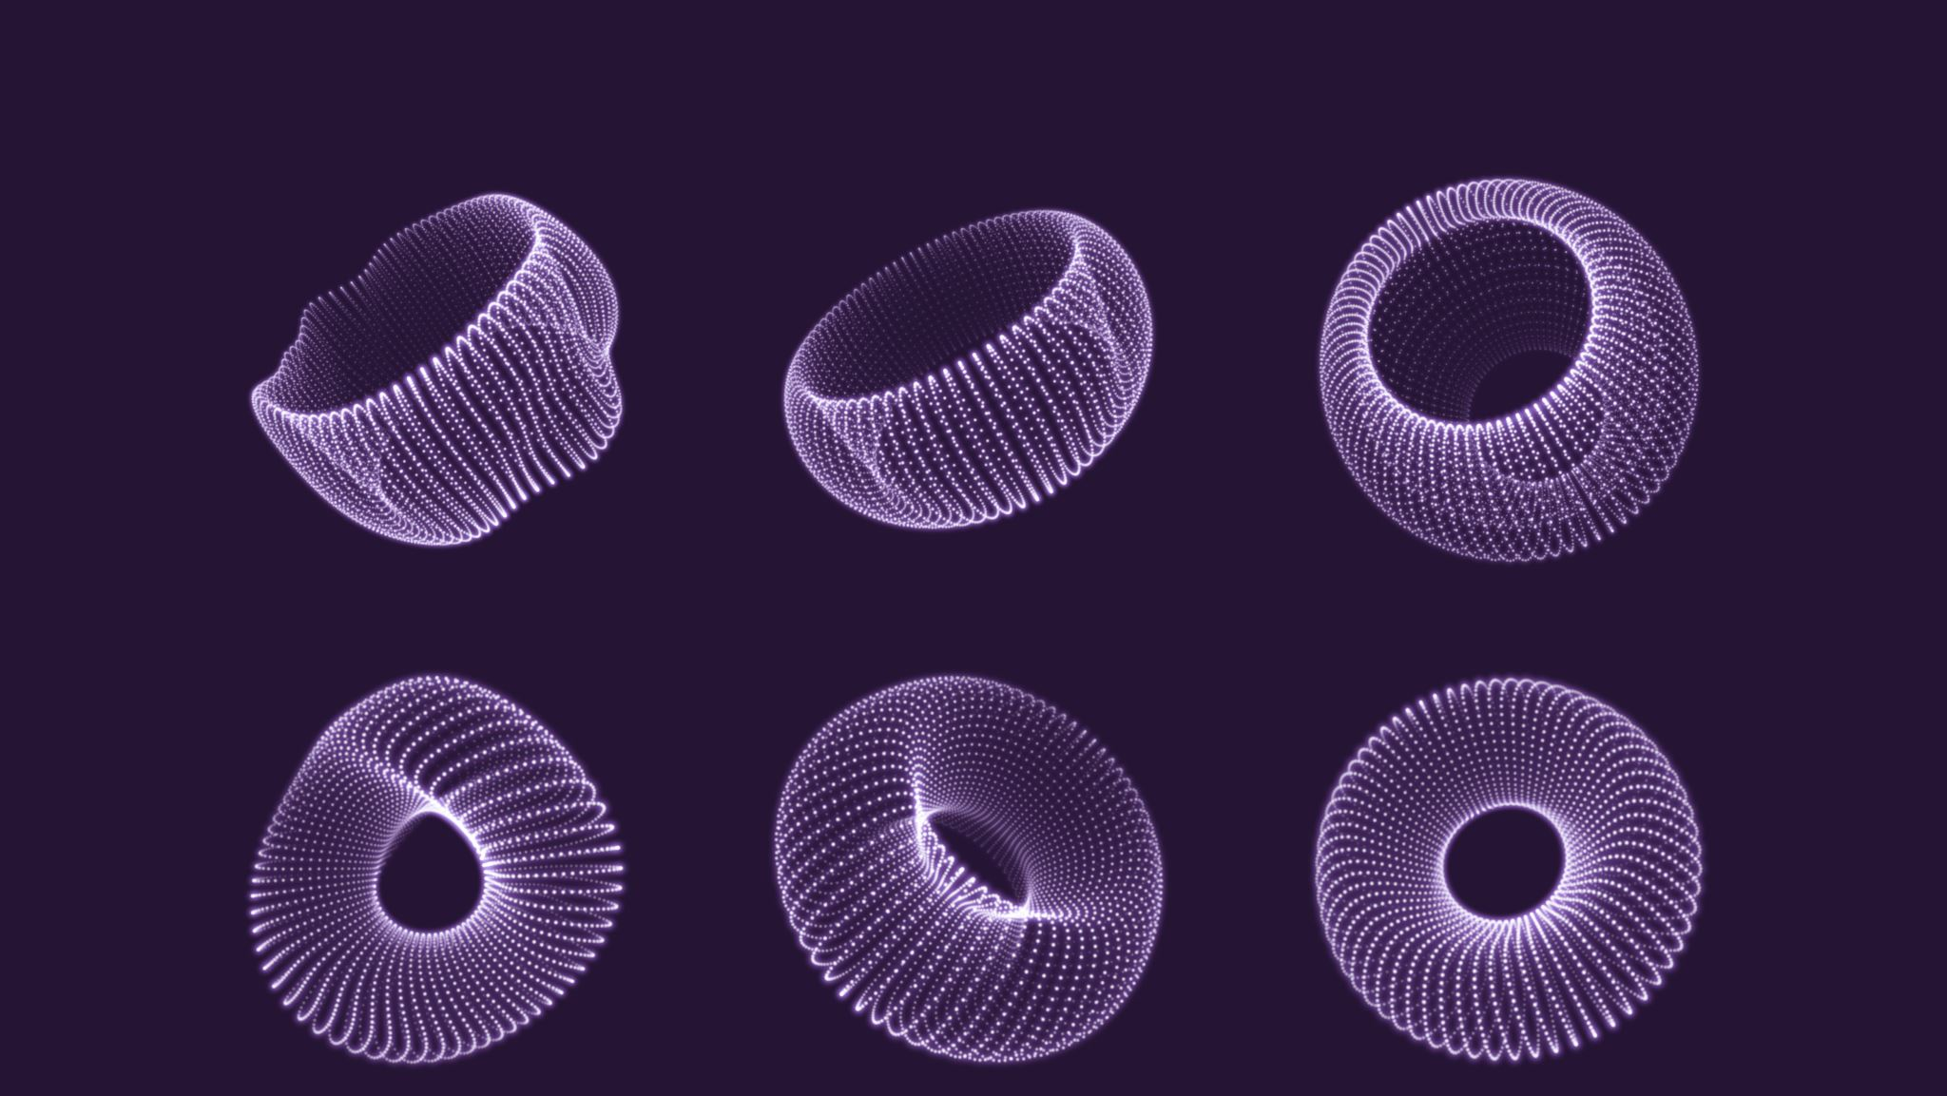
Vector
List of Node Groups
Add Noise
Cube Projection
Cylinder Projection
Landscape Projection
Map Vector Attribute
Ping Pong Vector
Sphere Projection
Triplanner Projection
VXYZ arc

Slide 39
Add Nosie Description: Noise set-up for randomly displacing geometries. Cube Projection Description: Store a UV projection from all the sides of input geometry. Suitable for geometry with sharp corners like hard surface modelling. UV attribute name is “Cube_Projection”. Go to shader editor and add a attribute node and set attribute name to “Cube_Projection”. Cylinder Projection Description: Stores a UV projection, unlike “AST_Cube_Projection” this UV is three segmented. Two side Top7 and Bottom and a third sideways loop, just like a cylinder. Suitable for cylinder like geometry like pillars and tree trunks. UV attribute name is “Cylinder_Projection”. Go to shader editor and add an attribute node and set attribute name to “Cylinder_Projection”. Landscape Projection Description: Stores a UV projection from all the sides like “AST_Cube_Projection” , but Top and Bottom sides have very sharp edges and only show up in near completely flat areas. Making it ideal for texturing landscapes. Using default UV on landscapes creates angled textures which looks very ugly, It fixes that. You can control on what angle, top and bottom UV should show up. You can flip X and Y coordinates with alternate XY mask input. UV attribute name is “Landscape_Projection”. Go to shader editor and add a attribute node and set attribute name to “Landscape_Projection”.

Slide 40
Map Vector Attribute Description: Re-range the input vector attribute. Automatically clamps the minimum value to 0 and maximum value to 1. Ping Pong Vector Description: Ping Pong a Vector input similar to Fold Attribute. Sphere Projection Description: A projection that uses two ‘Arcs’ one going horizontally and other going vertically to create a UV. Useful in texturing spherical objects. It does not store the projection itself, use a store named attribute node to access this UV in shader editor. Triplanner Projection Description: Stores a UV Projection from all the sides with smoother fall off. Suitable for smoother geometry without sharp corners. On sharp geometry result will be unexpected. You can also control the falloff angle. UV attribute name is “Triplanner_Projection”. Go to shader editor and add a attribute node and set attribute name to “Triplanner_Projection”. XYZ arc Description: A vector of three arcs each going on separate axis. Each can be used to create radial weight or index on respected axis. Or combine two of them to create Spherical UVs. You are supposed to separate the output vector and re-combine as needed.

